Slide 1




Materials Management (MM)
Product
SAP ERP 6.0 EhP4
Global Bike Inc.
Level
Beginner
Focus
Cross-functional integration
Materials Management
In addition to the standard Materials Management slides, this presentation includes links to business process models provided by a team at Hochschule Harz in Germany led by Prof. Dr. Hans-Jürgen Scheruhn.
These business models represent the processes in the case study 100% and thus facilitate an integrated view on data, functions and persons responsible.
Each link in the presentation is indicated by the symbol . A list of all links can be found on the second last page.

Slide 2
Unit Overview
MM Organizational Structure
MM Master Data
MM Processes
  Procure-to-Pay Process

Slide 3
MM Organizational Structure (Materials Mgmt.)
Client
  An independent environment in the system
Company Code
  Smallest org unit for which you can maintain a legal set of books
Plant
  Operating area or branch within a company
    Manufacturing, distribution, purchasing or maintenance facility
Storage Location
  An organizational unit allowing differentiation between the various stocks of a material in a plant

Slide 4
MM Organizational Structure (Purchasing)
Purchasing Organization
  The buying activity for a plant takes place at the purchasing organization
  Organization unit responsible for procuring services and materials
  Negotiates conditions of the purchase with the vendors
Purchasing Group
  Key that represents the buyer or group of buyers who are responsible for certain purchasing activities
  Channel of communication for vendors
Notes:
A purchasing organization is an organizational unit within logistics subdividing an enterprise according to the requirements of Purchasing. It procures materials and services, negotiates conditions of purchase with vendors, and bears responsibility for such transactions.
A purchasing group is a group of buyers who are responsible for certain purchasing activities.
The purchasing group is:
- Internally responsible for procuring a material or a class of materials
- Usually the principal channel for a company's dealings with its vendors

Slide 5
Global Bike Structure for Materials Management
Global Bike
Client
Global Bike Inc.
Global Bike Germany GmbH
Company
Code
Dallas
San Diego
Miami
Heidelberg
Hamburg
Plant
Raw Materials
Trading Goods
Trading Goods
Raw Materials
Trading Goods
Storage
Location
Semi-fin. Goods
Finished Goods
Finished Goods
Semi-fin. Goods
Finished Goods
Finished Goods
Miscellaneous
Miscellaneous
Finished Goods
Miscellaneous
Miscellaneous
Miscellaneous

Slide 6
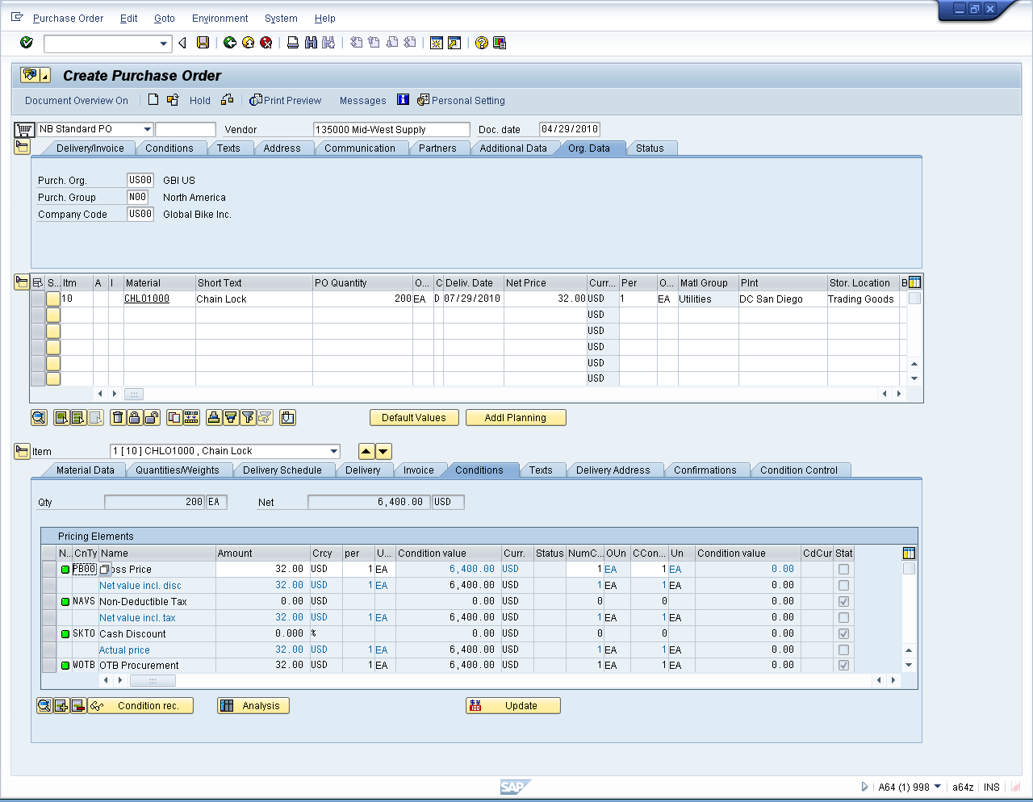
MM Master Data
Vendor Master Data
Material Master Data
Purchasing Info Record
Condition Master Data
Output Master Data

Slide 7
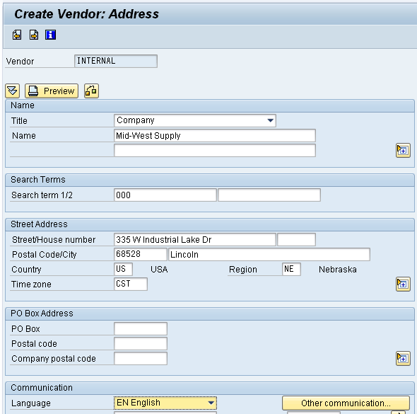
Vendor Master Data
Vendor Master
  Contains all the necessary information needed to business with an external supplier
  Used and maintained primarily by the Purchasing and Accounting Departments
  Every vendor MUST have a master record
Screen Diagram Vendor

Slide 8
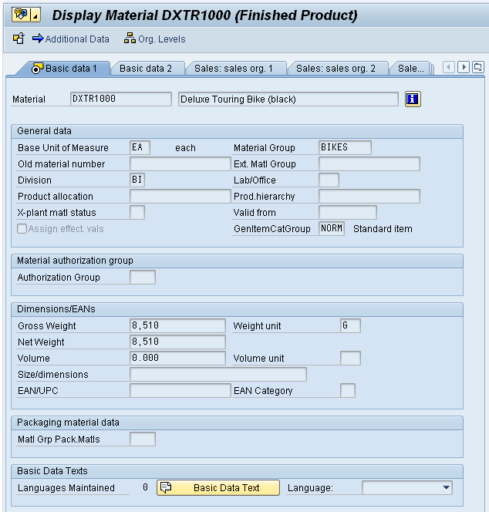
Material Master Data
Material Master
  Contains all the information a company needs to manage about a material
  It is used by most components within the SAP system
    Sales and Distribution
    Materials Management
    Production
    Plant Maintenance
    Accounting/Controlling
    Quality Management
  Material master data is stored in functional segments called Views
Screen Diagram Material

Slide 9
Purchasing Information Record
Framework for Purchase Order
  Contains the relationship between a vendor and a material
Can be created:
  Manually
  Automatically – Quotations
  Automatically – Purch. Orders
Reporting
  Vendor Evaluation
Purchasing
Information Record
Material Master
Vendor Master

Slide 10
Purchasing Information Record
Allows buyers to quickly determine:
  Which vendors have offered or supplied specific materials
Info Records contain:
  Data on pricing and conditions
  Last purchase order
  Tolerance limits for deliveries
  Specific lead times
  Availability periods
  Vendor Evaluation data
Serves as default information for Purchase Orders
Data Model MM

Slide 11

Procure-To-Pay Process
Purchase
Requisition
Vendor
Selection
Purchase
Order
Notify
Vendor
Payment
to Vendor
Invoice
Receipt
Vendor
Shipment
Goods
Receipt
Notes:
This is a standard view of the procure to pay process and the most common. It may vary significantly based upon the company procedures, the products/services purchases and other factors.
SAP allow businesses to tailor it to their needs.
Starts with a requisition or need that needs to be filled. This can come from Planning (MRP), manually or other
The purchase order is the document to fill the need: usually includes the vendor, cost/price, quantity, terms and other pertinent information. [ part one of the 3-way match]
Notifying the vendor
The goods are shipped and brought to the organization
The goods are received (typically at the dock) and then put away [ part two of the three way match]
An invoice is received from the vendor [third part of the 3-way match]
After the tolerances/verification of the 3-way match are met a payment is made according to the terms agreed to on the purchase order.

